Slide 1
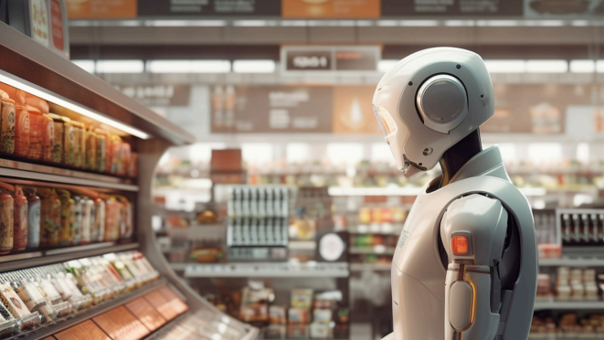
Computer Science Capstone Project
Team Name: TEAM MISSION POSSIBLE
(deadly by name & game)
Team 4

Slide 2
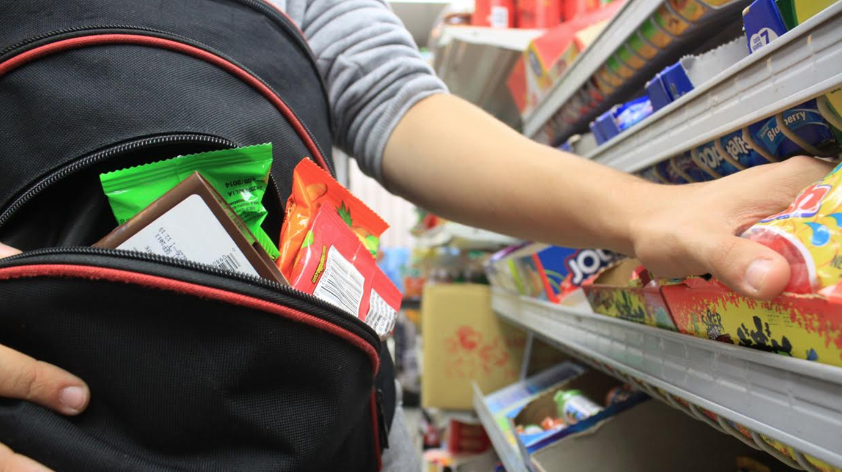


Slide 3

Team Member Roles and
Responsibilities
Improvements made from Professor Feedback
Project
Statement
Project
Description
Team Working
Agreement
Personas
Minimal Viable Product (MVP)
Technologies
Architecture
Diagrams
Schedule
Recap Sprint 1 Backlog
Product Backlog
Sprint 2 Backlog
Test cases
Stories Completed
Stories Not Completed
Metrics
Retrospective
Sprint 3 Backlog
Project Demo
GitHub Link
Live Application Demo

Slide 4
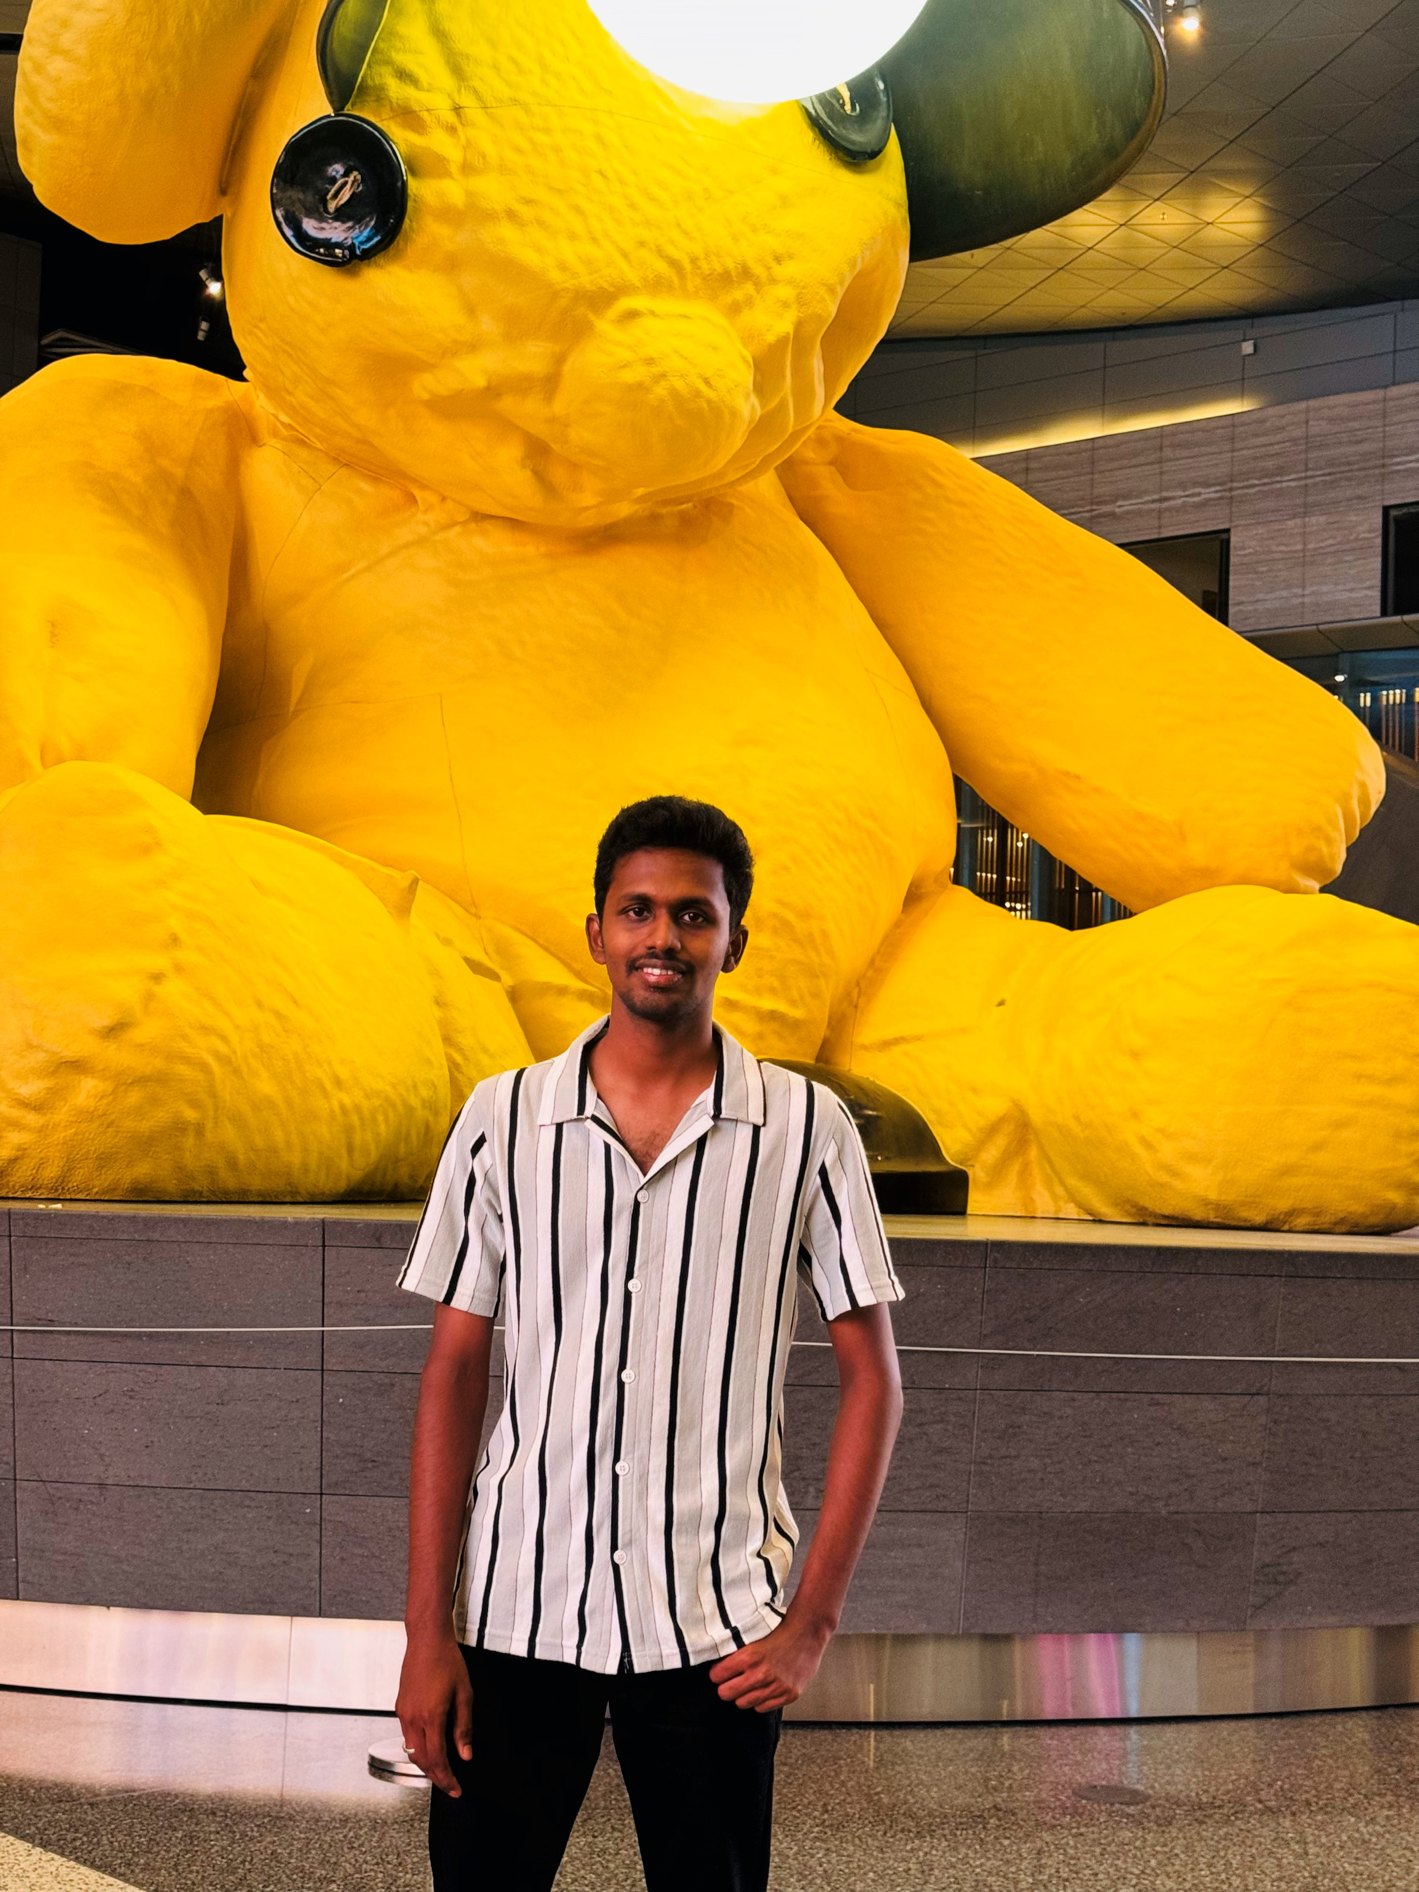
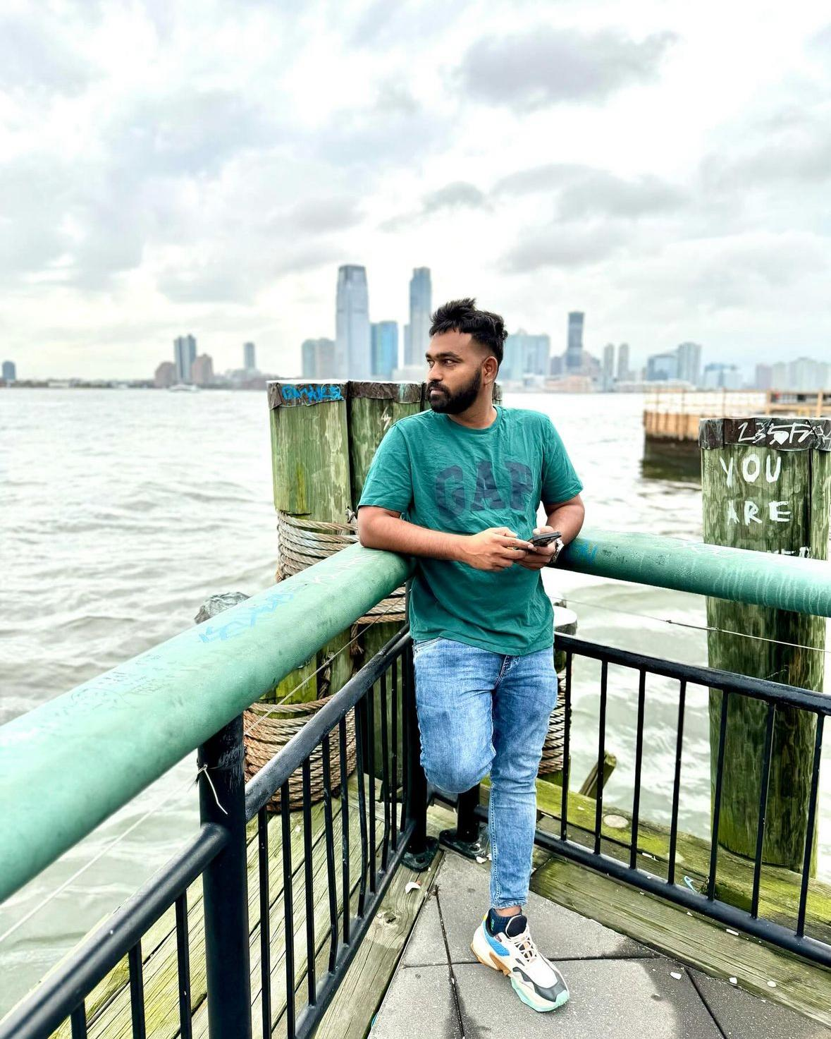

TEAM MEMBER ROLES
Shiva
Data Scientist
Prudhvi
Full Stack Developer
Vinod
Data Analyst & Product Developer

Slide 5
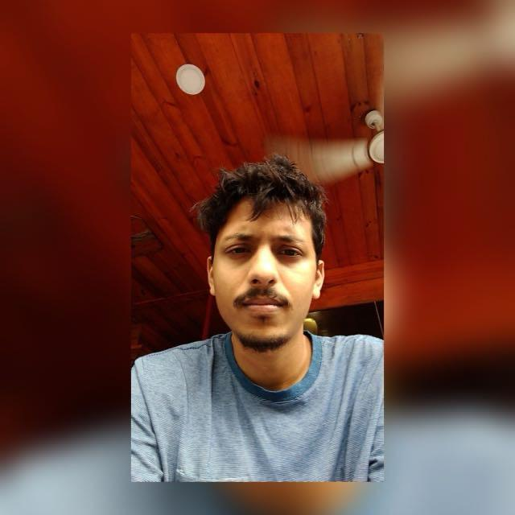

TEAM MEMBER ROLES
Mayank
Artificial Intelligence Engineer & Project Manager
Vishnu Raju
Software Developer

Slide 6
Improvements made from Feedback Professor
User stories must be formatted differently by the examples provided.
You must include a historical velocity chart.
The schedule slide must be altered.
It is necessary to replace the feature rather than add it to the sprint backlog table.
Every PowerPoint slide must be explained.

Slide 7

PROJECT STATEMENT
Shoplifting is a significant problem for supermarkets, leading to financial losses and higher customer prices. Current security methods often react to theft after it has already happened, which is ineffective. There is a clear need for a better solution that can prevent theft before it occurs. Our project aims to develop a Supermarket Theft Detection System that uses advanced technology to monitor customer behavior in real time, including computer vision and machine learning. This system will help identify suspicious activities and alert security personnel immediately, allowing them to respond quickly and reduce theft incidents. By analyzing data on theft patterns, supermarket managers can also make informed decisions to enhance security and improve the shopping experience for all customers.

Slide 8

PROJECT DESCRIPTION
Project Name: | Theft Alert
Team: | TEAM MISSION POSSIBLE (deadly by name & game)
Project Description: | The Supermarket Theft Detection System uses existing CCTV cameras and machine learning to proactively monitor customer behavior, detect suspicious activities, and alert security personnel, significantly enhancing store safety and reducing theft losses.. For retail stores who struggle with shoplifting, the Supermarket Theft Detection System is a proactive solution that leverages existing CCTV cameras and machine learning that monitor customer behavior in real time and alert security personnel. Unlike traditional reactive security measures, our application detects suspicious activities before theft occurs, significantly reducing losses and enhancing store safety.
Benefit Outcomes: | Minimizes financial losses from shoplifting. Enables quick responses from security personnel with real-time alerts. Fosters a safer shopping environment for honest customers. Provides valuable analytics on theft patterns for informed decision-making. Adaptable for implementation across multiple store locations. Works with existing security infrastructure for a smooth transition. Allows for upgrades, such as improved facial recognition and behavior prediction. Combines technology and human oversight for effective theft prevention.
GitHub Link: | https://github.com/htmw/2024F-Team4/wiki

Slide 9

PROJECT DESCRIPTION
Shoplifting poses a significant challenge for retail stores, leading to financial losses and increased consumer prices. Traditional security measures are largely reactive, addressing theft only after it occurs. Our project aims to develop a Supermarket Theft Detection System that utilizes existing CCTV cameras and machine learning to monitor customer behavior in real-time. The system will analyze video footage for unusual movements and automatically alert security personnel to potential theft, enabling quick responses. This proactive approach reduces theft losses and enhances the shopping experience by fostering a safer environment. Additionally, the system is scalable for multiple locations and integrates seamlessly with current security infrastructure. By providing valuable insights into theft patterns, our innovative solution aims to revolutionize supermarket security and improve overall safety for customers and staff.

Slide 10
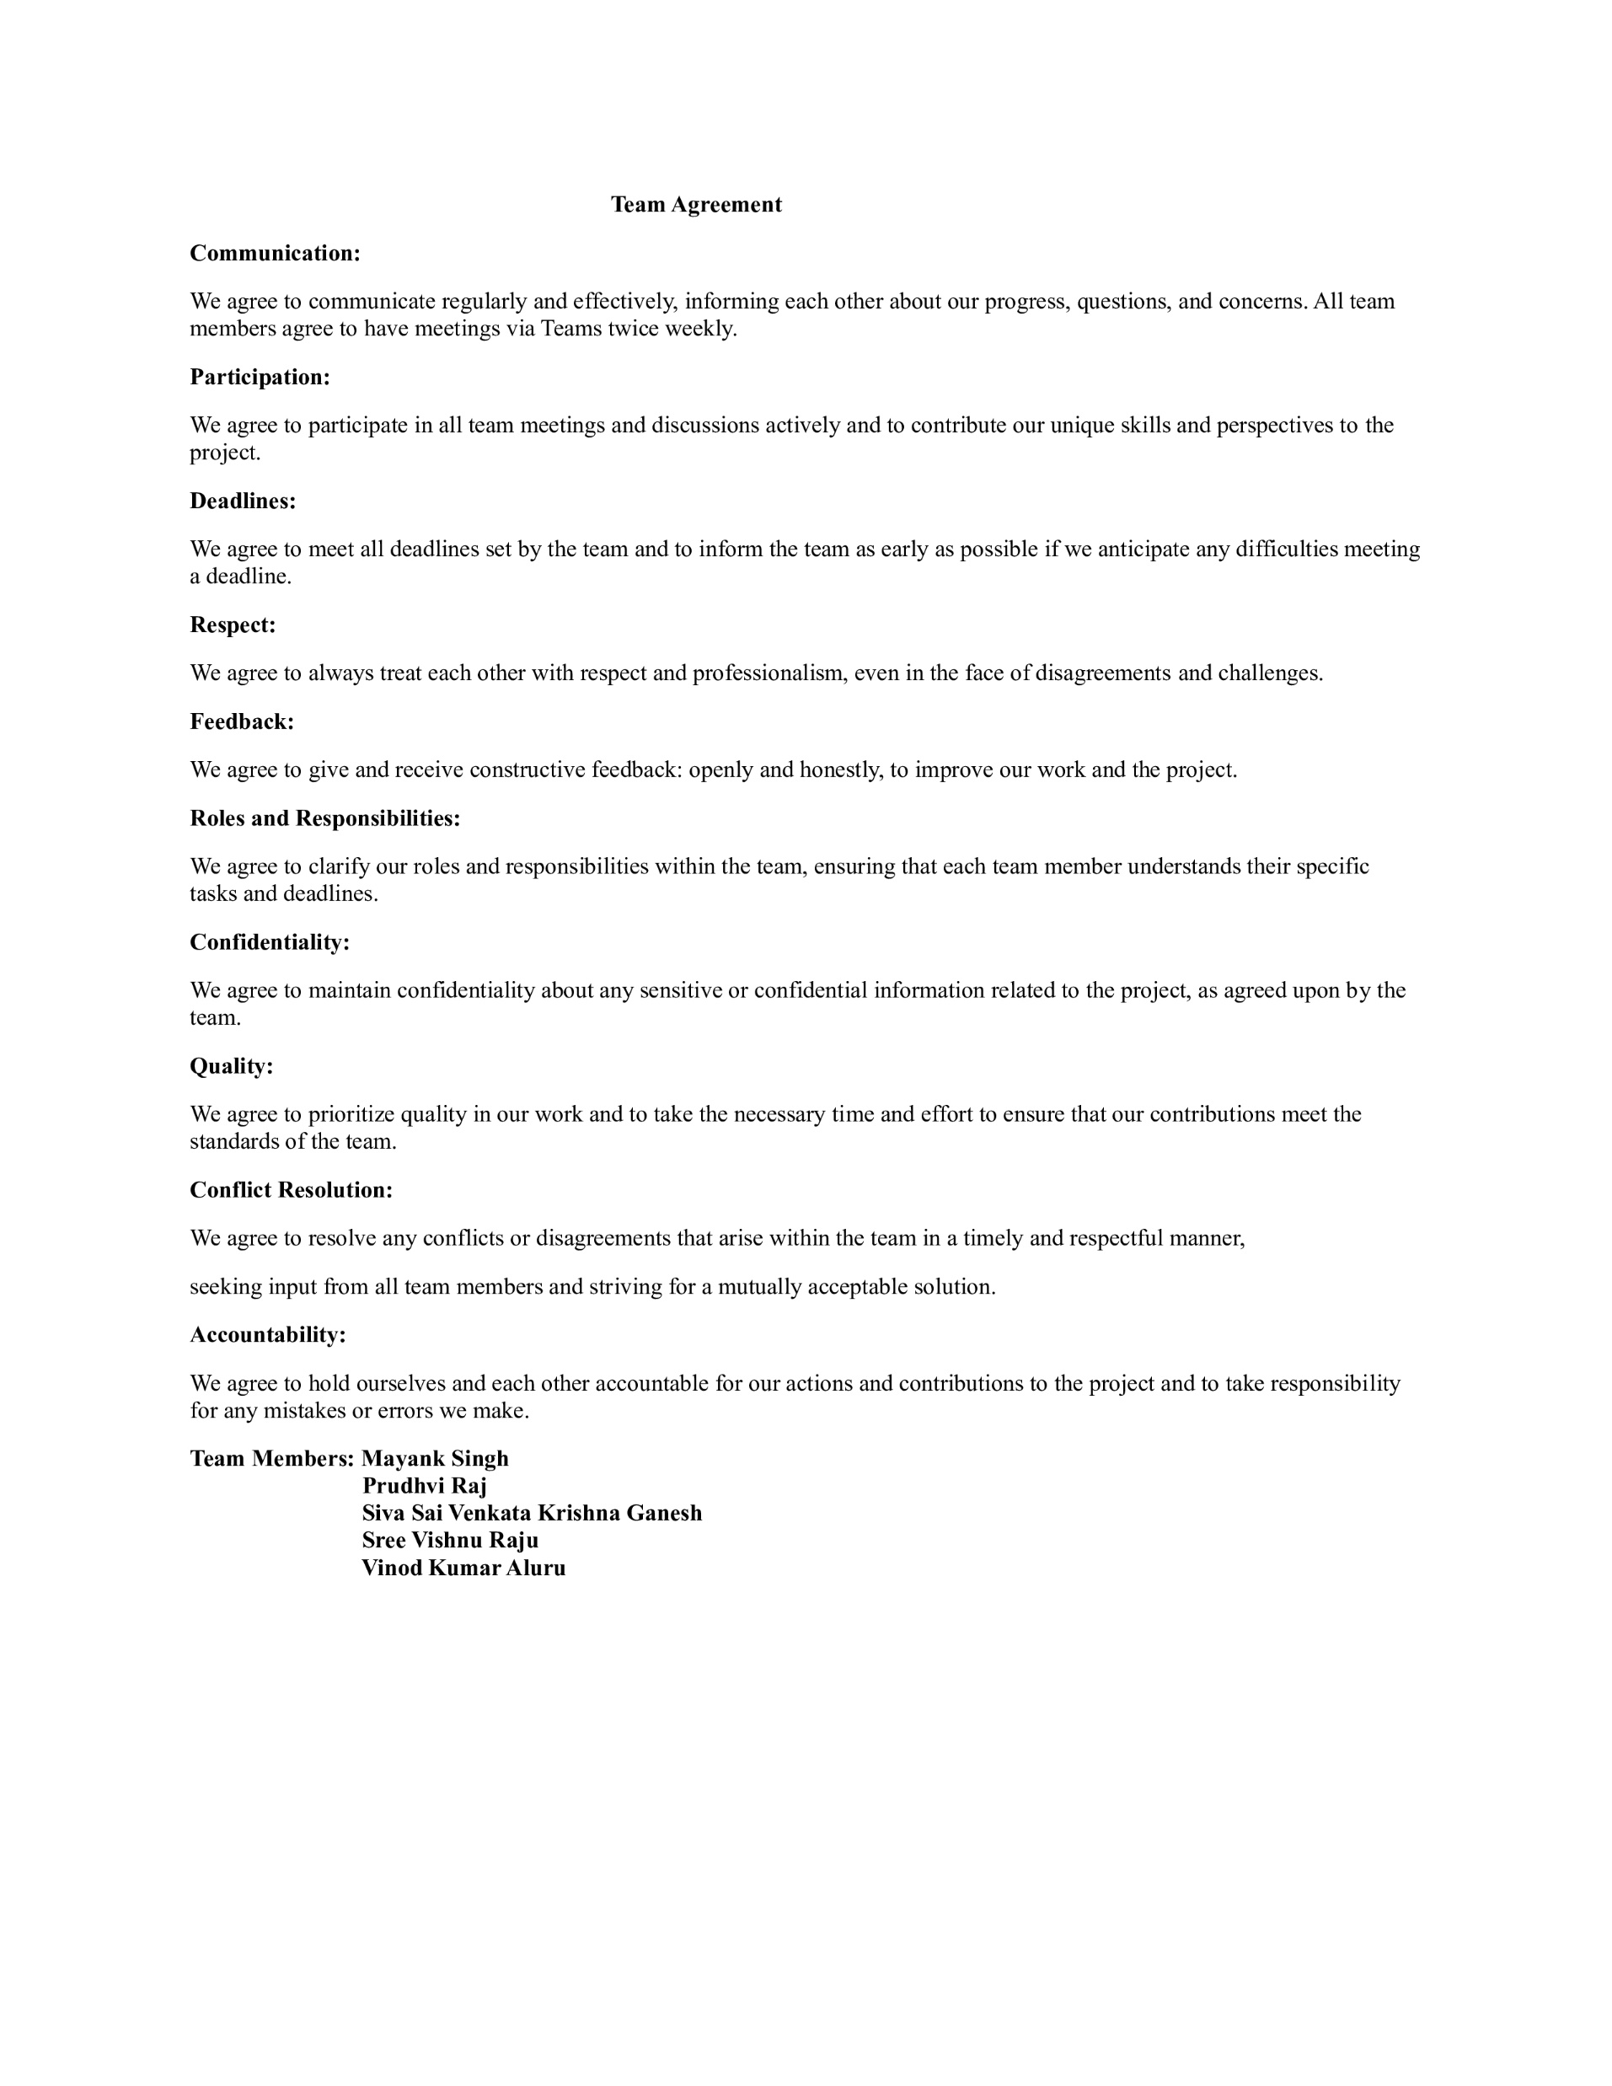

TEAM WORKING AGREEMENT

Slide 11

PERSONAS

Slide 12

PERSONAS - 1
James, a dedicated Chief Security Officer, oversees the safety of a large retail complex, drawing on years of experience to identify and mitigate potential threats.
Challenges:
Managing security across a large retail complex can be overwhelming, especially with limited personnel.
Managing security across a large retail complex can be overwhelming, especially with limited personnel.
Coordinating with multiple security personnel across a large complex can be difficult, especially when managing complex incidents that require a unified response.
James needs a way to quickly find relevant footage, especially during an incident or investigation.
Goals:
A real-time video monitoring system with AI features like facial recognition and automated alerts will help James efficiently monitor multiple areas and quickly identify threats.
Advanced systems that facilitate quick footage retrieval and automated tagging will streamline the review process, allowing James to save time and efficiently locate critical information.
Profile
Name: James
Age: 30
Location: Alabama, Ga
Job: Chief Security Officer
Salary: $112000/year
Family: wife

Slide 13
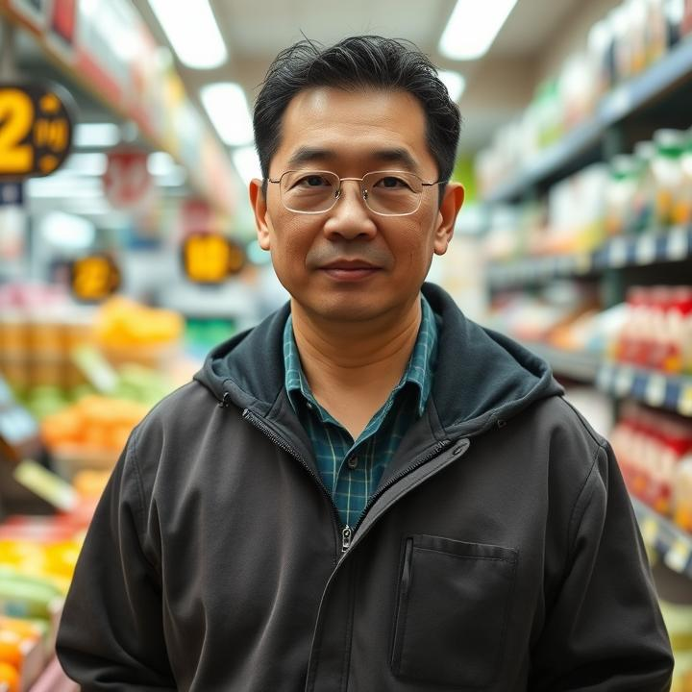
PERSONAS - 2
Mr. Wong is a dedicated convenience store owner managing a bustling shop in a vibrant neighborhood.
Challenges:
As foot traffic increases, it becomes more difficult for Mr. Wong to monitor every customer and transaction effectively, which can lead to security risks such as theft or fraudulent activities.
As a busy store owner, Mr. Wong must ensure the safety of his employees while they work, particularly during late-night shifts or in high-risk situations.
Convenience stores are often targets for shoplifting, and with more customers in-store, identifying suspicious behavior manually can be very challenging.
Goals:
A user-friendly, integrated surveillance system that provides clear alerts and easy-to-navigate interfaces will save Mr. Wong time and effort, allowing him to focus on other aspects of his business without constant troubleshooting.
Implementing an advanced surveillance system with real-time monitoring allows Mr. Wong to remotely oversee his store, enhancing security and efficiency.
Profile
Name: Mr. Wong
Age: 45
Location: New York, NY
Job: Store Owner
Family: Two children and wife

Slide 14

PERSONAS - 3
Ms. Rodriguez is a dedicated supermarket manager, responsible for the bustling operations of a large grocery store.
Challenges:
In a dynamic retail environment, it is challenging to pinpoint areas where customer flow or store layout may be causing delays or dissatisfaction without data-driven insights.
With a constantly changing shopping environment, ensuring the store layout is optimized for both customer flow and product accessibility is a time-consuming task.
Ms. Rodriguez effectively monitors every aspect of the store, which could lead to inefficiencies or missed opportunities to improve customer experience.
Goals:
She aims to use the system's data to identify bottlenecks and optimize store layout and product placement for a smoother shopping experience.
The system will enable Ms. Rodriguez to monitor customer activity and enhance customer experience.
Ms. Rodriguez plans to leverage the data to improve store performance, increase customer satisfaction, and create a safer, more enjoyable shopping experience.
Profile
Name: Rodriguez
Age: 27
Location: New Jersey, NJ
Job: Supermarket Manager
Salary: $125000/year
Family: Lives with her boyfriend

Slide 15











TECHNOLOGIES
IDE & Additional Tools
Frontend
Backend
Database
Communication

Slide 16
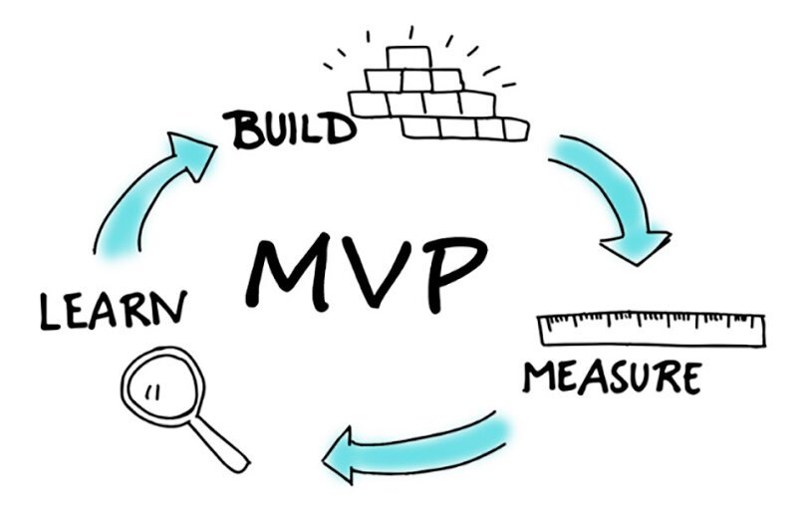
MINIMAL VIABLE PRODUCT
(MVP)

Slide 17
MINIMAL VIABLE PRODUCT
(MVP)
Real-time CCTV Integration - CCTV cameras to monitor customer behavior in the store.
Machine Learning Model for Theft Detection - Implement a machine learning algorithm trained to recognize basic suspicious behaviors.
Instant Alerts for Security Personnel - Set up a simple alert system to notify store security when potential theft is detected.
Data Logging for Monitoring - Enable security teams to review footage or logs in case of false positives or to understand detected patterns better.
User Interface for Security Personnel - The interface should allow security staff to assess the situation quickly.
Focus on the essentials - Streamline your video workflow with tools to upload, organize, and watch your videos.

Slide 18

ARCHITECTURE DIAGRAM

Slide 19
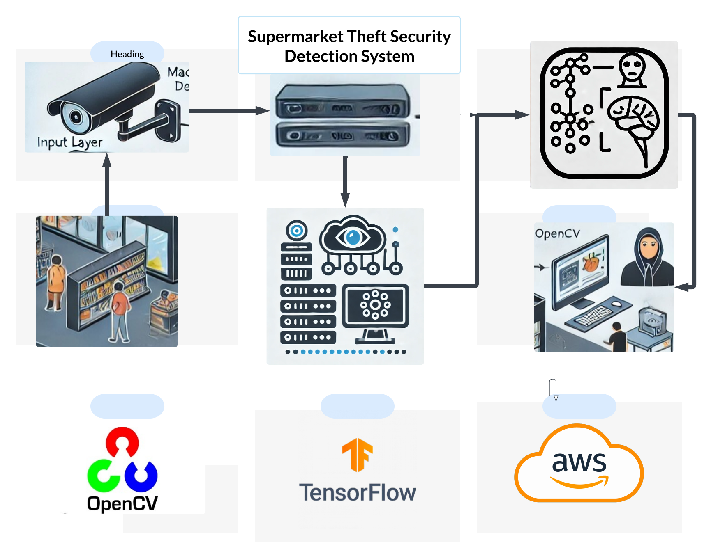
CONCEPTUAL ARCHITECTURE DIAGRAM

Slide 20
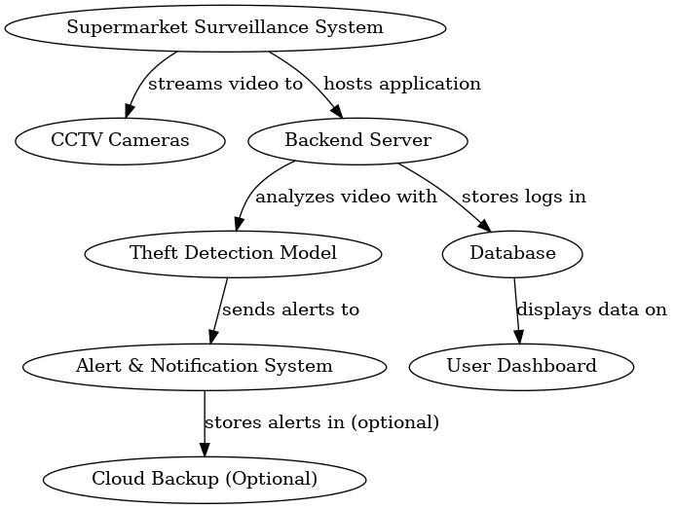
DATA FLOW DIAGRAM

Slide 21
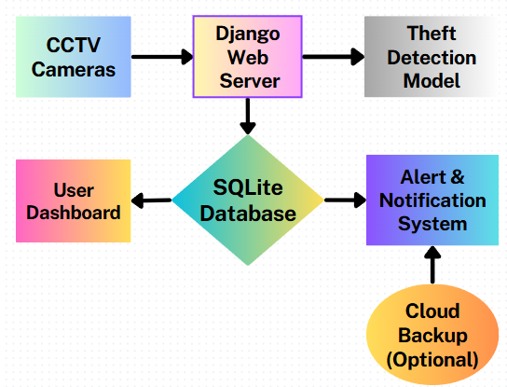
SURVEILLANCE SYSTEM ARCHITECTURE

Slide 22
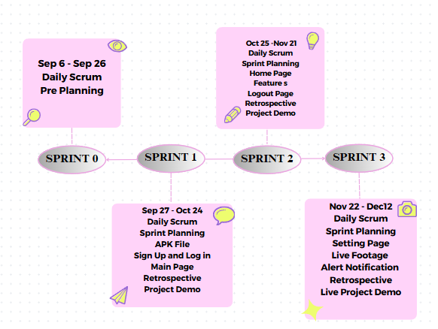
SCHEDULE

Slide 23
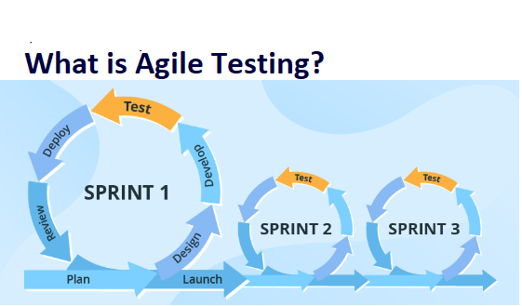
SPRINT SUMMARY

Slide 24
SPRINT 1 RECAP
User Story ID | Issue Type | User Story | Story Points | Status
TA - 6 | User Story |  | 3 | Done
TA - 7 | User Story |  | 8 | Done
TA – 8 | User Story |  | 3 | Done
TA – 9 | User Story |  | 5 | Done
TA - 10 | User Story |  | 5 | Done
As a user, I should have an APK file that can be installed on a mobile device, so that I can access the application's basic functionalities.
As a user, I want to create an account for the application by signing up with my name, email, and password, so that I can keep my account private.
As a user, I want to register in the application by providing my username, so that I can create an account and access its features.
As a user, I want to log in to the application using my user ID, so that I can access my account.
As a registered user, I want to see the main page after logging into the application, so that I can access its features.

Slide 25
SPRINT 2 RECAP
User Story ID | Issue Type | User Story | Story Points | Status
TA – 11 | User Story | As a registered user, I want the option to log out of the application, so that I can securely end my session and log in again when needed | 3 | Done
TA – 12 | User Story | As a user, I want to easily view the features on the homepage so that I can quickly explore and understand what the platform offers. | 3 | Done
TA – 13 | User Story | As a user, I want to navigate between pages so that I can quickly access the features. | 5 | Done
TA – 14 | User Story | As a user, I want to upload new videos so that I can watch Them later. | 8 | Done
TA - 15 | User Story | As a registered user, I want the option to change my name on the settings page, so that I can easily update my profile information. | 3 | To Do

Slide 26
PRODUCT BACKLOG
User Story ID | Issue Type | User Story | Story Points
TA – 1 | Task | To gather all the requirements for the project. | 8
TA – 2 | Task | As a team we should have work agreement with all rules and regulations. | 3
TA – 3 | Task | As a team we should divide roles and responsibilities among ourselves to develop the project. | 5
TA – 4 | Task | As a team we should develop required technical and functional knowledge required to complete the project. | 5
TA – 5 | Task | As a team we should plan the product requirements and development plan for the project. | 3
TA – 6 | User Story | As a user, I want an APK file that can be installed on a mobile device, so that I can access the application's basic functionalities. | 3
TA – 7 | User Story | As a user, I want to create an account for the application using my name, email, and password, so that I can keep my account private. | 8
TA – 8 | User Story | As a user, I should be able to provide a username and get registered in the application | 3
TA – 9 | User Story | As a user, I want to log in using my user ID, so that I can access my account. | 5
TA - 10 | User Story | As a registered user I should be able to see the Main page, once I login the application. | 5

Slide 27
PRODUCT BACKLOG
User Story ID | Issue Type | User Story | Story Points
TA – 11 | User Story | As a registered user, I want the option to log out of the application, so that I can securely end my session and log in again whenever needed. | 3
TA – 12 | User Story | As a user, I want to easily view the features on the homepage so that I can quickly explore and understand what the platform offers. | 3
TA – 13 | User Story | As a user, I want to navigate between pages so that I can quickly access the features. | 5
\ TA – 14 | User Story | As a user, I want to upload new videos so that I can view them later. | 8
TA – 15 | User Story | As a registered user, I want to see the option to change my name on the settings page, so that I can easily update my profile name | 5
TA – 16 | User Story | As a registered user, I want to access live footage so that I can watch live feed . | 5
TA – 17 | User Story | As a registered user, I want a functionality to enable alerts so that I can be notified about important updates. | 5
TA – 18 | Task | Preparing Deployment Manual | 3
TA – 19 | Task | Preparing User Manual | 3
TA – 20 | Task | Preparing Tech Paper | 3

Slide 28
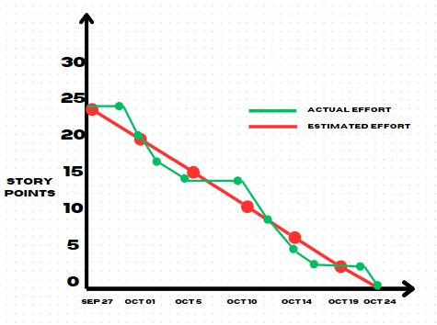
Sprint 1 Burndown Charts
We committed to 24 story points and completed 24 story points.

Slide 29
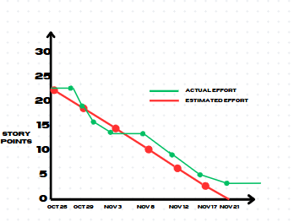
Sprint 2 Burndown Charts
We committed to 22 story points and completed 19 story points.

Slide 30
SPRINT 3 BACKLOG
User Story ID | Issue Type | User Story | Acceptance Criteria | Feature | Story Points
TA – 15 | User Story | As a registered user, I want to see the option to change the user’s name on the settings page so that I can easily change the profile name. | Given the user is logged in, when they enter a valid username and click "Save," then the username should be updated, or an error message displayed. | Setting Page | 5
TA – 16 | User Story | As a registered user, I want to access live footage so that I can watch live videos too. | Given the user is logged in, when they go to the Live Videos section, then they should be able to watch live streams. If no live stream is available, a message like "No live streams available" should show. | Live Footage page | 5
TA – 17 | User Story | As a registered user, I want a functionality to enable alerts so that I can be notified about important updates. | Given that the user is logged in, when they visit the Settings page, they should see an option to turn alerts on or off. If alerts are on, they should receive notifications for important updates. | Notification Page | 5

Slide 31
TEST CASES
Test ID | User Story ID | User Story | Test Data | Steps to be taken | Expected Result | Actual Result
TT ID-11 | TA – 15 | As a registered user, I want to see the option to change the user’s name on the settings page so that I can easily change the profile name. | Username: Vinod Password: Vinod@99 | Log in and go to the Settings page. Enter a new, valid username in the "New Username" field and click "Save". | The "New Username" field and "Save" buttons are visible. After clicking "Save", the username should update with a success message or show an error if the username is invalid. | The "New Username" field and "Save" button appear. Upon submitting a valid username, it updates successfully with a confirmation message, or an error appears if the username is invalid.
TT ID-12 | TA – 16 | As a registered user, I want to access live footage so that I can watch live videos too. | Username: Vinod Password: Vinod@99 | When the user logs in and navigates to the Live Videos section, they should click on a live stream to ensure it plays smoothly with options to pause and resume. If no streams are available, the user should see the message "No live streams available." | The live stream should play smoothly, with options to pause and resume. If no stream is available, the message "No live streams available" should be displayed. | The live stream plays without issues; if no streams are available, the message "No live streams available" appears.

Slide 32
TEST CASES
Test ID | User Story ID | User Story | Test Data | Steps to be taken | Expected Result | Actual Result
TT ID-13 | TA – 17 | As a registered user, I want a functionality to enable alerts so that I can be notified about important updates. | Username: Vinod Password: Vinod@99 | When the user logs in and navigates to the ‘Settings’ page, they should find the alert option. The user should toggle the alert setting to either enable or disable notifications. Then, the user should check whether they receive notifications based on their preference. | The user should see an option to enable or disable alerts in the Settings page. If alerts are enabled, they should receive notifications for important updates, and if disabled, no notifications should be sent. | The alert option is visible and functional in the ‘Settings’. When enabled, the user receives notifications as expected, and when disabled, no notifications are sent.

Slide 33
Stories Completed
User Story ID | Issue Type | User Story | Story Points | Status
TA – 15 | User Story | As a registered user, I want to see the option to change the user’s name on the settings page so that I can easily change the name of profile. | 5 | Done
TA – 16 | User Story | As a registered user, I want to access live footage so that I can watch live videos too. | 5 | Done
TA – 17 | User Story | As a registered user, I want a functionality to enable alerts so that I can be notified about important updates. | 5 | Done
TA – 18 | Task | Preparing Deployment Manual | 3 | Done
TA – 19 | Task | Preparing User Manual | 3 | Done
TA – 20 | Task | Preparing Tech Paper | 3 | Done

Slide 34
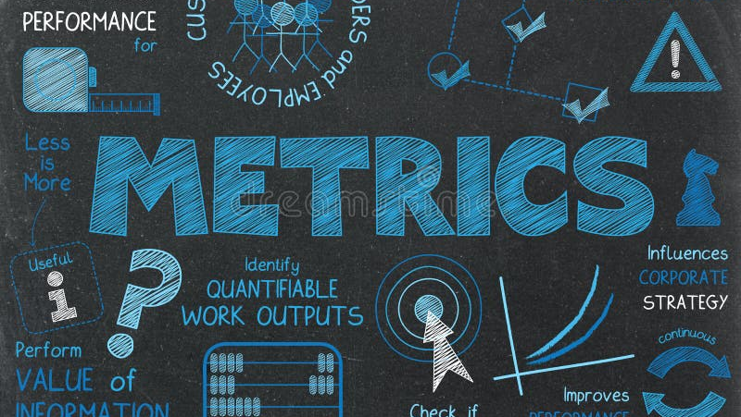

Slide 35
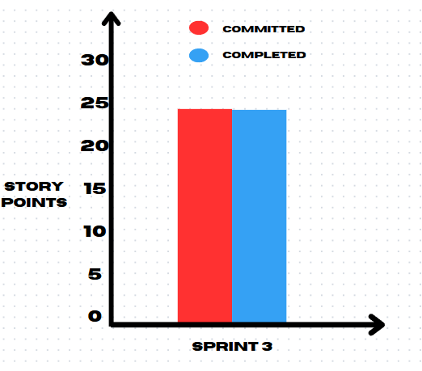
Team Velocity Chart

Slide 36
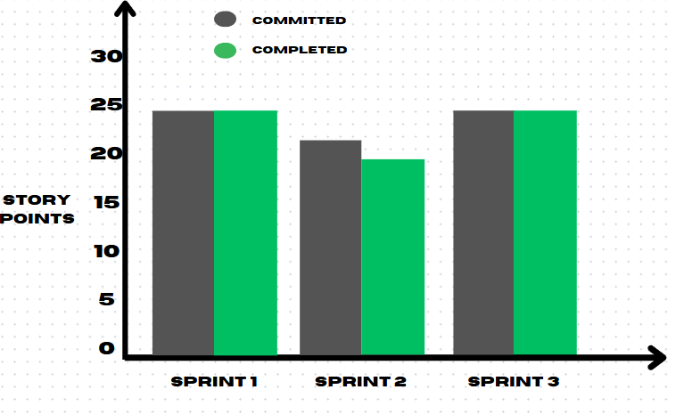
Team Historical Velocity Chart

Slide 37
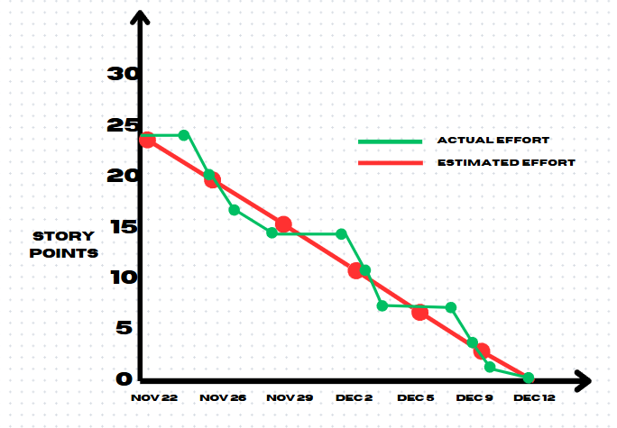
Burndown Charts
We committed to 24 story points and completed 24 story points.

Slide 38
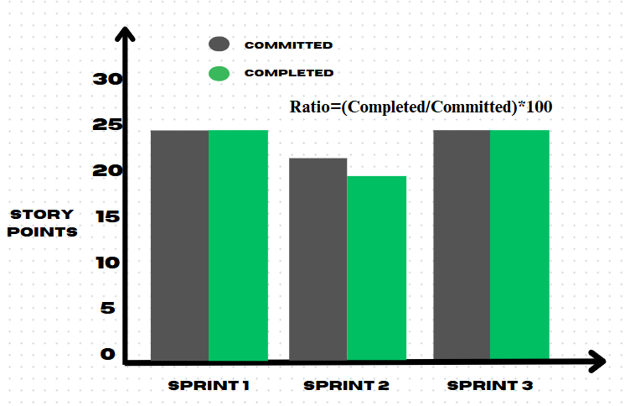
Completed/Committed Ratio
Sprint | Sprint 1 | Sprint 2 | Sprint 3
Committed | 24 | 22 | 24
Completed | 24 | 19 | 24
Ratio % | 100% | 86.3% | 100%

Slide 39
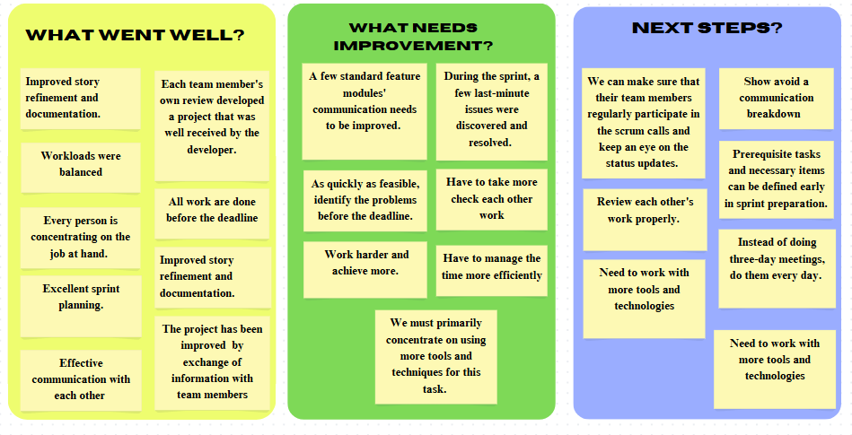
RETROSPECTIVE
Improved story in terms of refinement and documentation
A few standard featured modules needs to have improved intra communication
During sprint, few last-minute issues were discovered and resolved
To make sure that team members regularly participate in scrum calls and update status more frequently
To avoid effective communication breakdown
Each team member part of the project was well received by the developer
Work loads were balanced
Instead of conducting three day meetings conduct them everyday
Identifying problems quickly and solving them before deadline
Frequent checks of each others work is required
All work is done before the deadline
Review each other’s work more diligently
Everyone was focused on the job at hand
Need to have more knowledge on existing tools
Excellent sprint planning
To manage time more efficiently
There always room for extra work
Some prerequisite tasks and necessary items should be defined earlier in sprint preparation
Effective communication with one another
Project was substantially improved by exchange of information amongst the team
We should focus on using more tools and techniques for a given task
Have more detailed knowledge on newer technologies
Everybody came up with original ideas

Slide 40


Slide 41
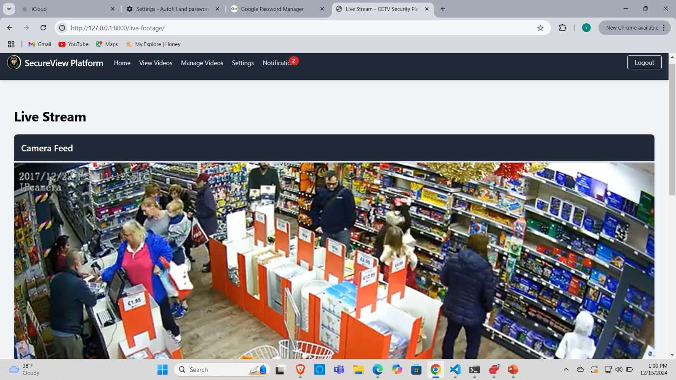
PROJECT DEMO SCREENSHOTS

Slide 42
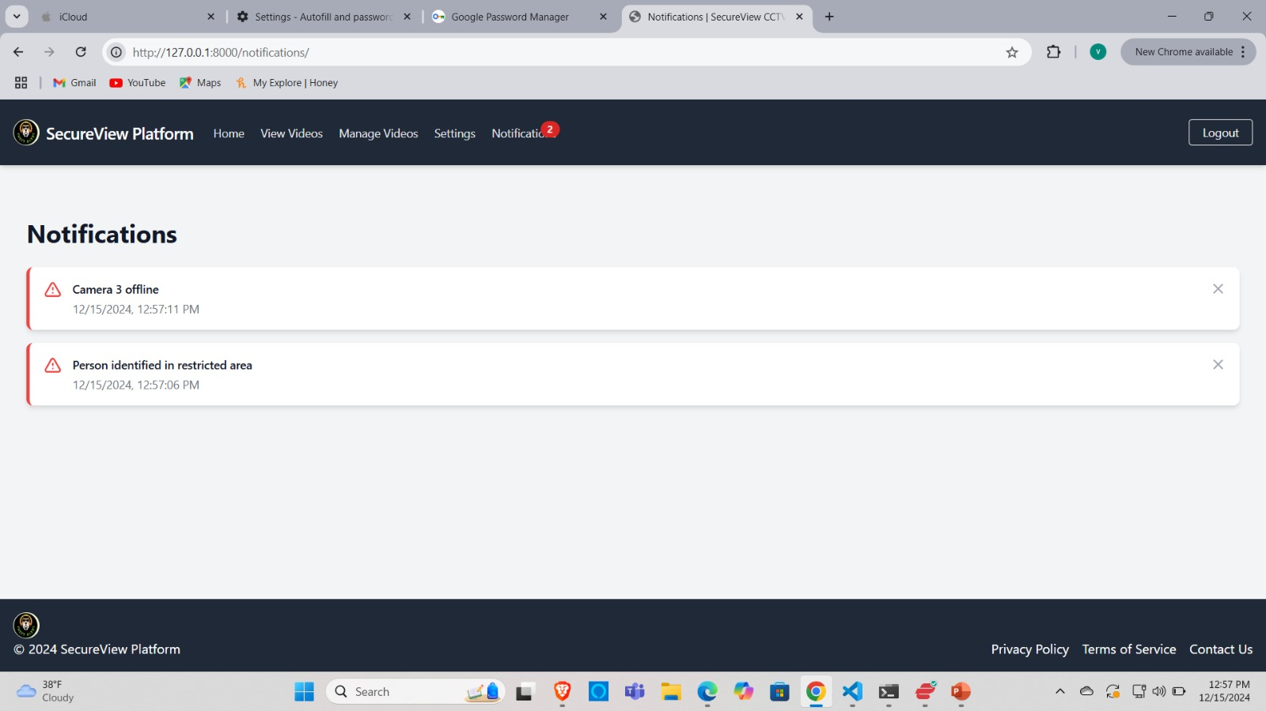
PROJECT DEMO SCREENSHOTS

Slide 43
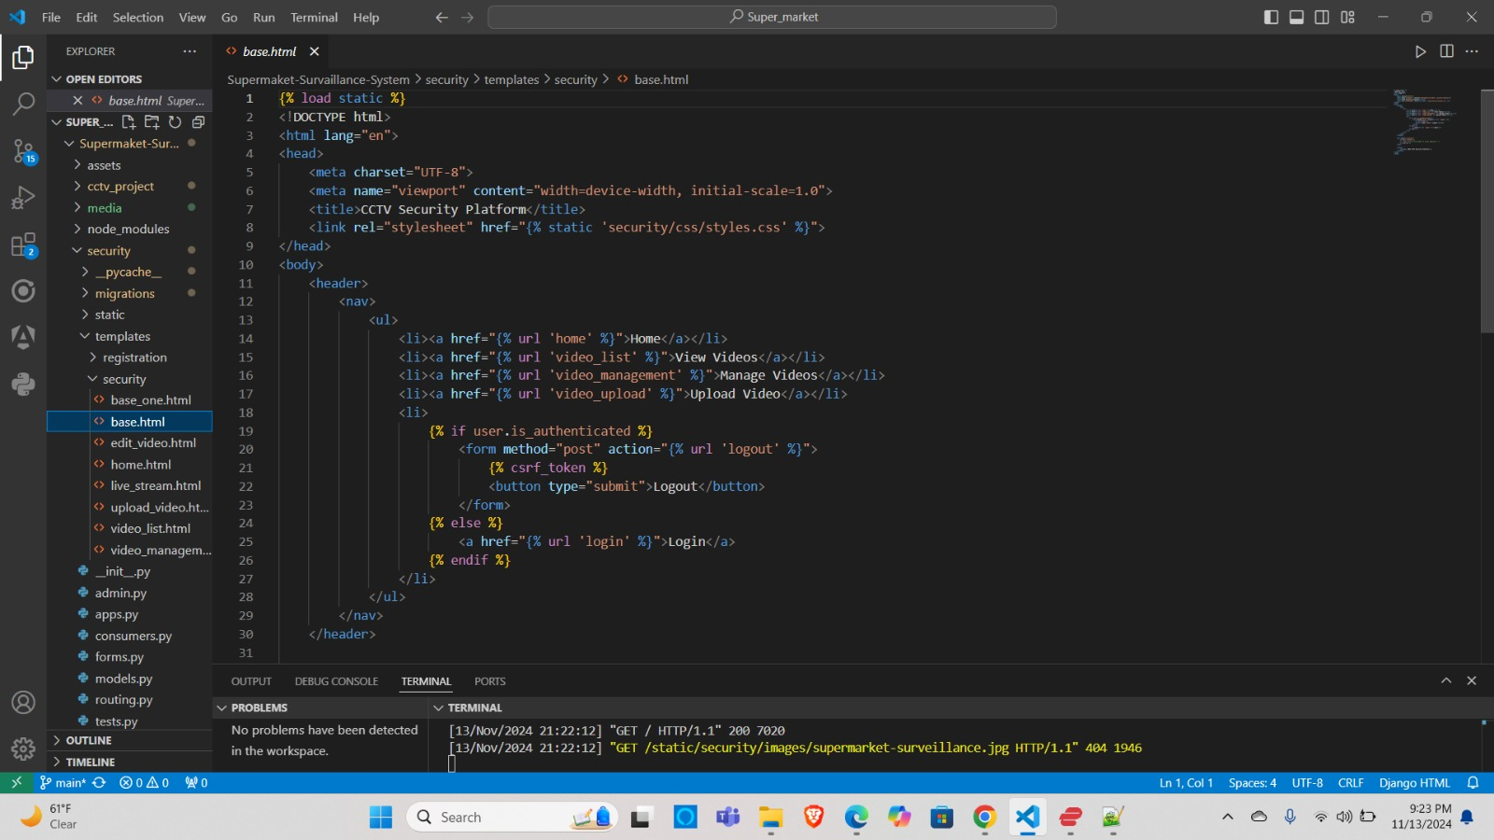
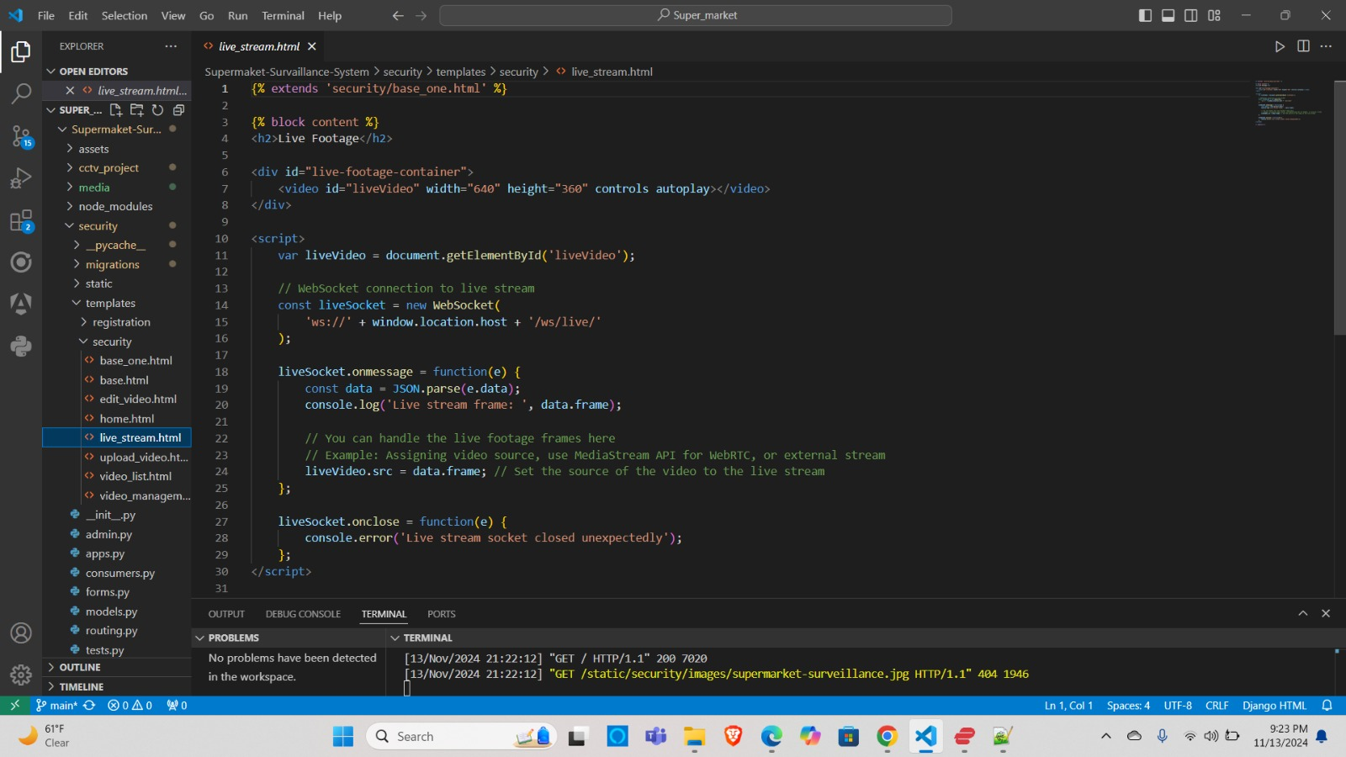
PROJECT DEMO SCREENSHOTS

Slide 44
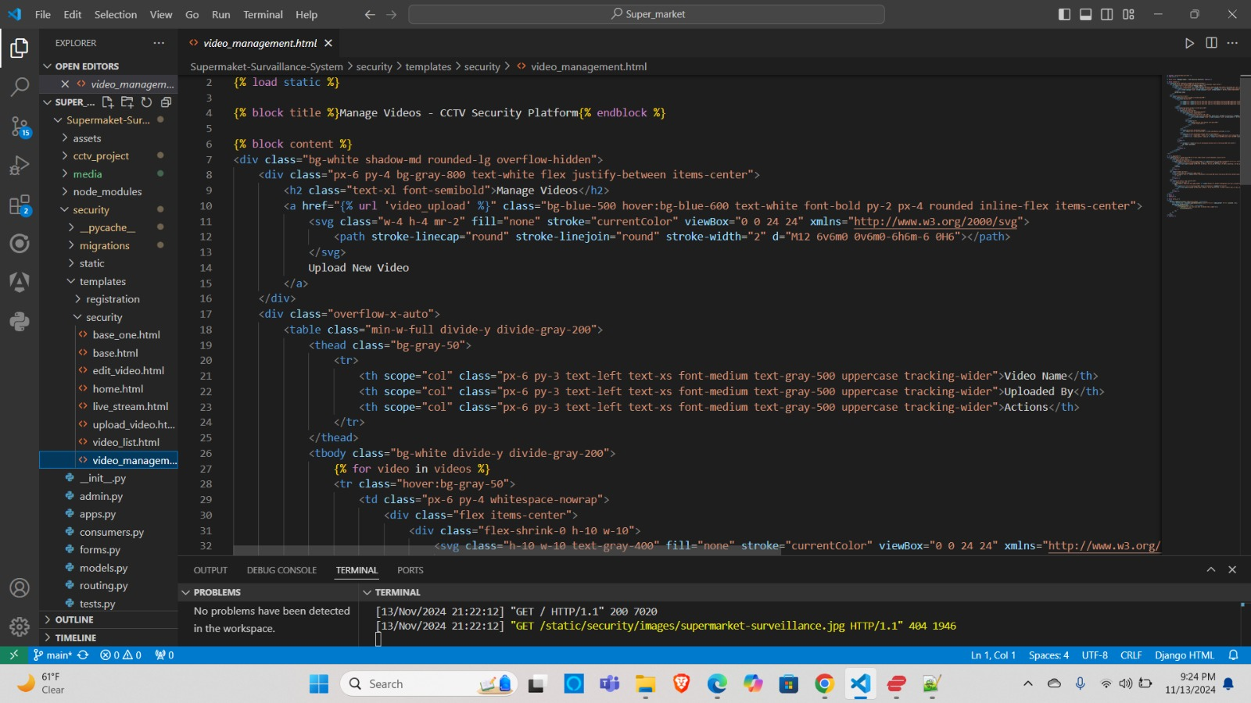
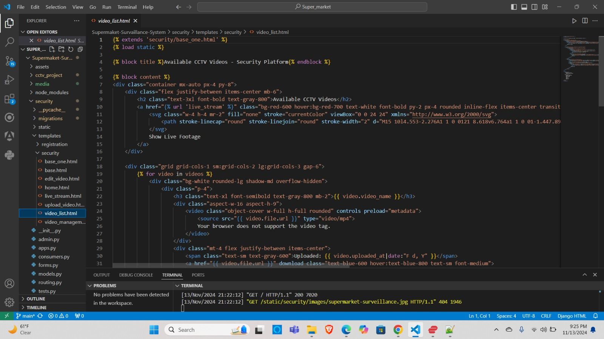
PROJECT DEMO SCREENSHOTS

Slide 45
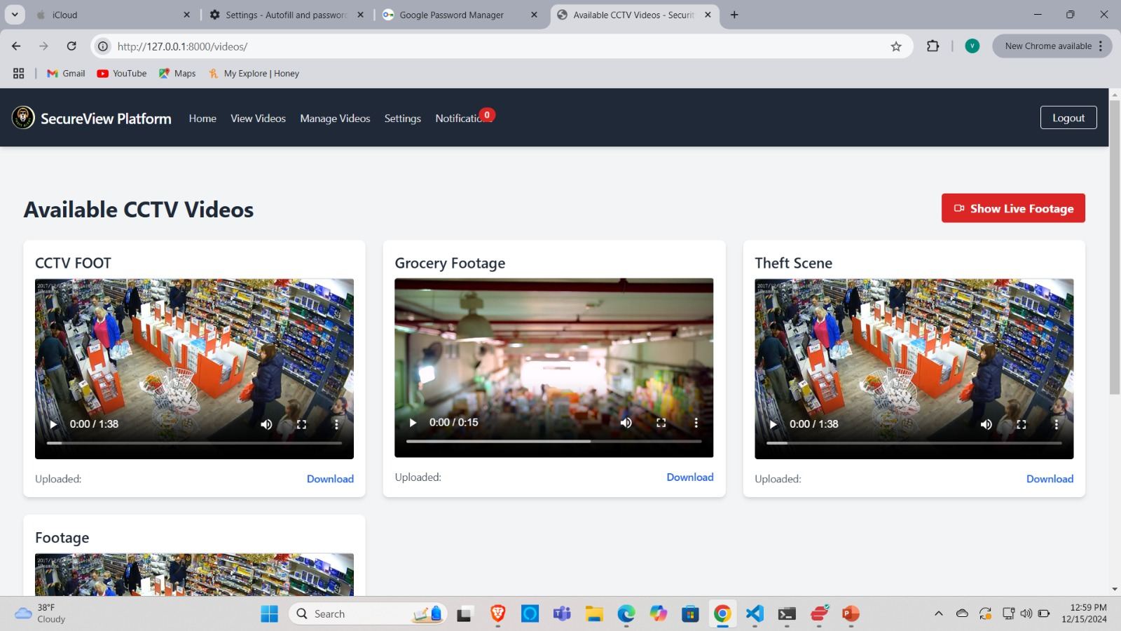
PROJECT DEMO SCREENSHOTS

Slide 46
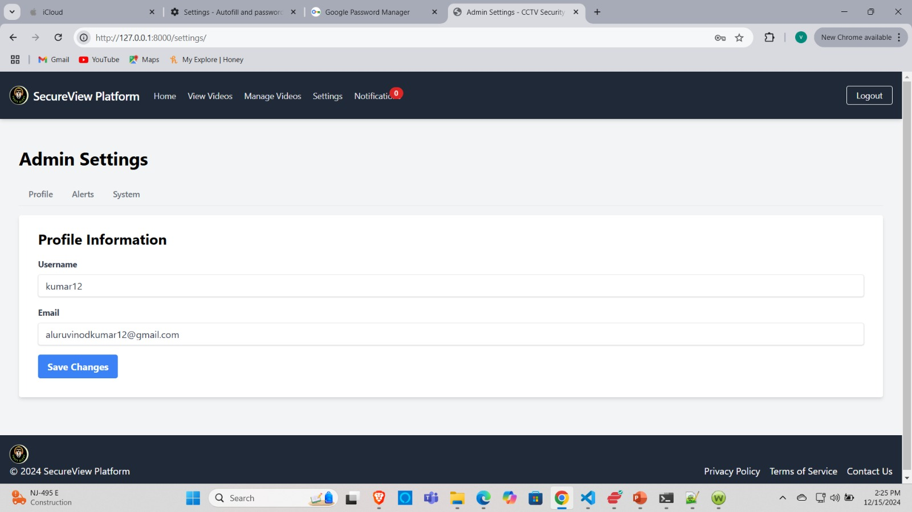
PROJECT DEMO SCREENSHOTS

Slide 47
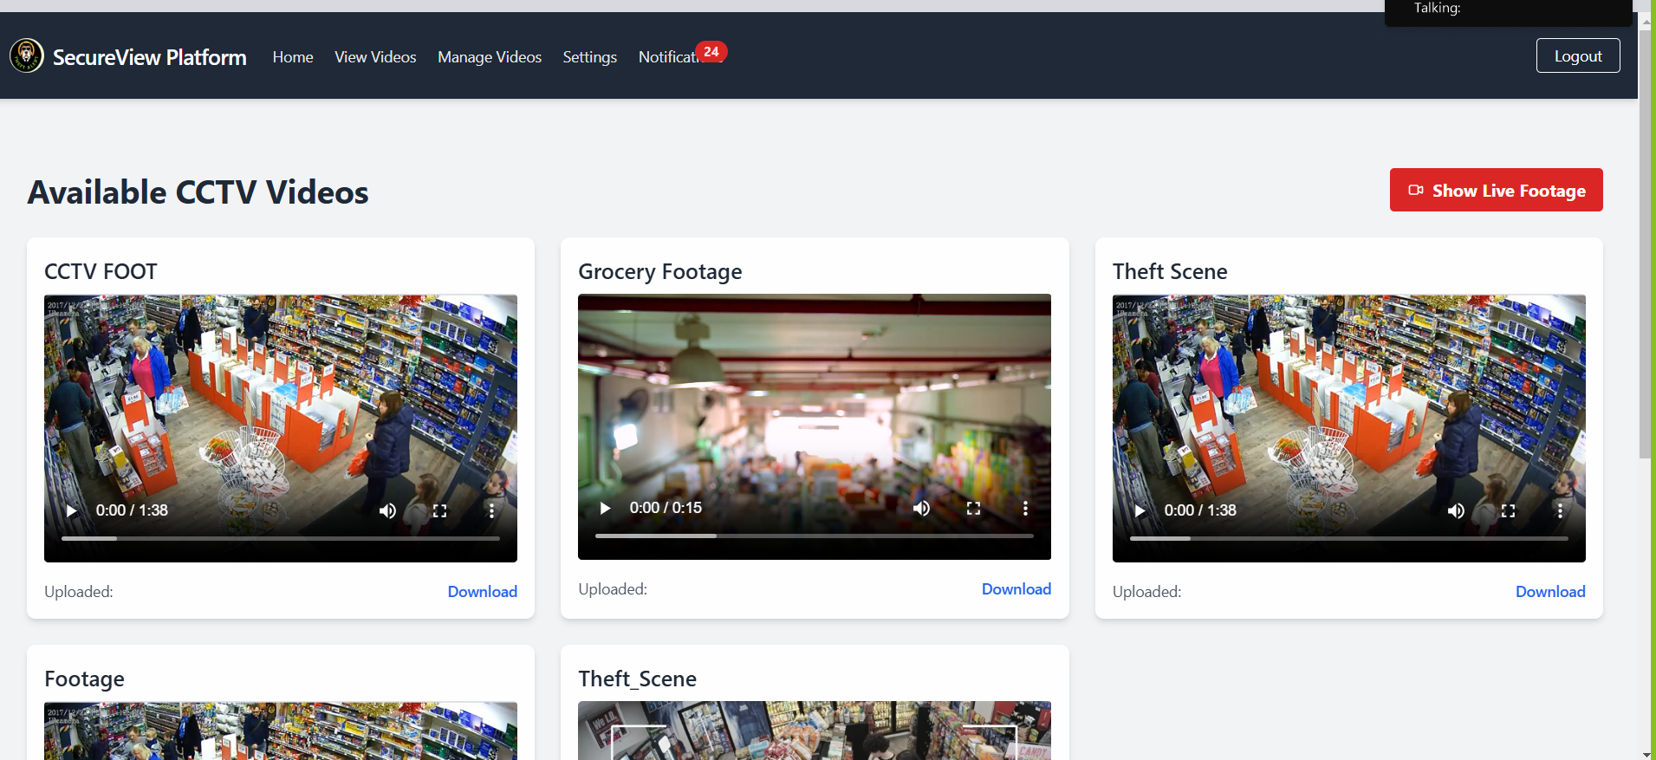
LIVE APPLICATION DEMO

Slide 48


GITHUB LINK
https://github.com/htmw/2024F-Team4/wiki

Slide 49


